Slide 1
ELECTRICAL SCIENCE-1 (15B11EC111) UNIT-2 Lecture-4

Slide 2
Topics to be Discussed
Mesh analysis
Practice Problem
References

Slide 3
Mesh Analysis Limitations
It is applicable only to those planar networks which contain only independent voltage sources.
If there is a practical current source, it can be converted to an equivalent practical voltage source.

Slide 4
Procedure for Mesh Analysis
Make sure that the network is planar.
Make sure that it contains only independent voltage sources.
Assign clockwise mesh currents.
Write mesh equations in matrix form by inspection. An element on the principal diagonal is the self-resistance of the mesh. These elements are all positive. An element off the major diagonal is negative (or zero)

Slide 5
5. Check the symmetry of resistance matrix about the major diagonal.
An element of the voltage source column matrix on the right side represents the algebraic sum of the voltage sources that produce current in the same direction as the assumed mesh current.
Solve the equations to determine the unknown mesh currents, using Cramer’s rule.
Determine the branch currents and voltages.

Slide 6
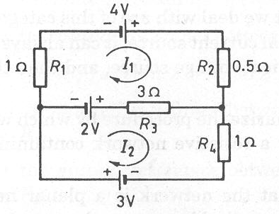
Example
Determine the currents in various resistances of the network shown.

Slide 7
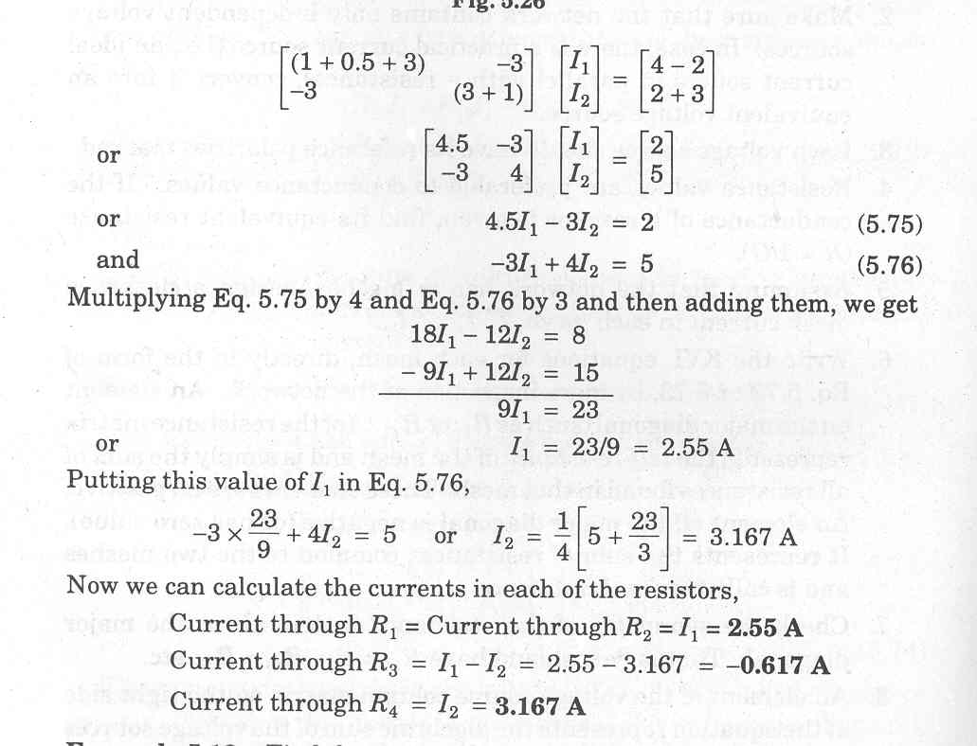
Writing the mesh equations by inspection,
Solving, we get I₁ = 2.55 A, I₂ = 3.167 A

Slide 8
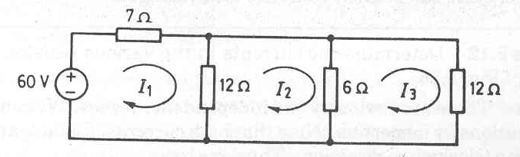
Example
Find the current drawn from the source in the network, using mesh analysis.

Slide 9
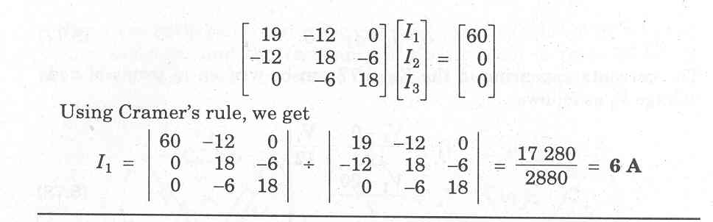

Slide 10
mesh analysis

Slide 11
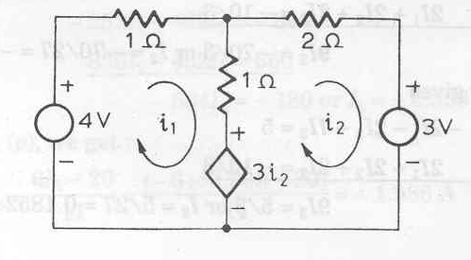
Example
Find the currents i₁ and i₂ in the circuit given below.

Slide 12
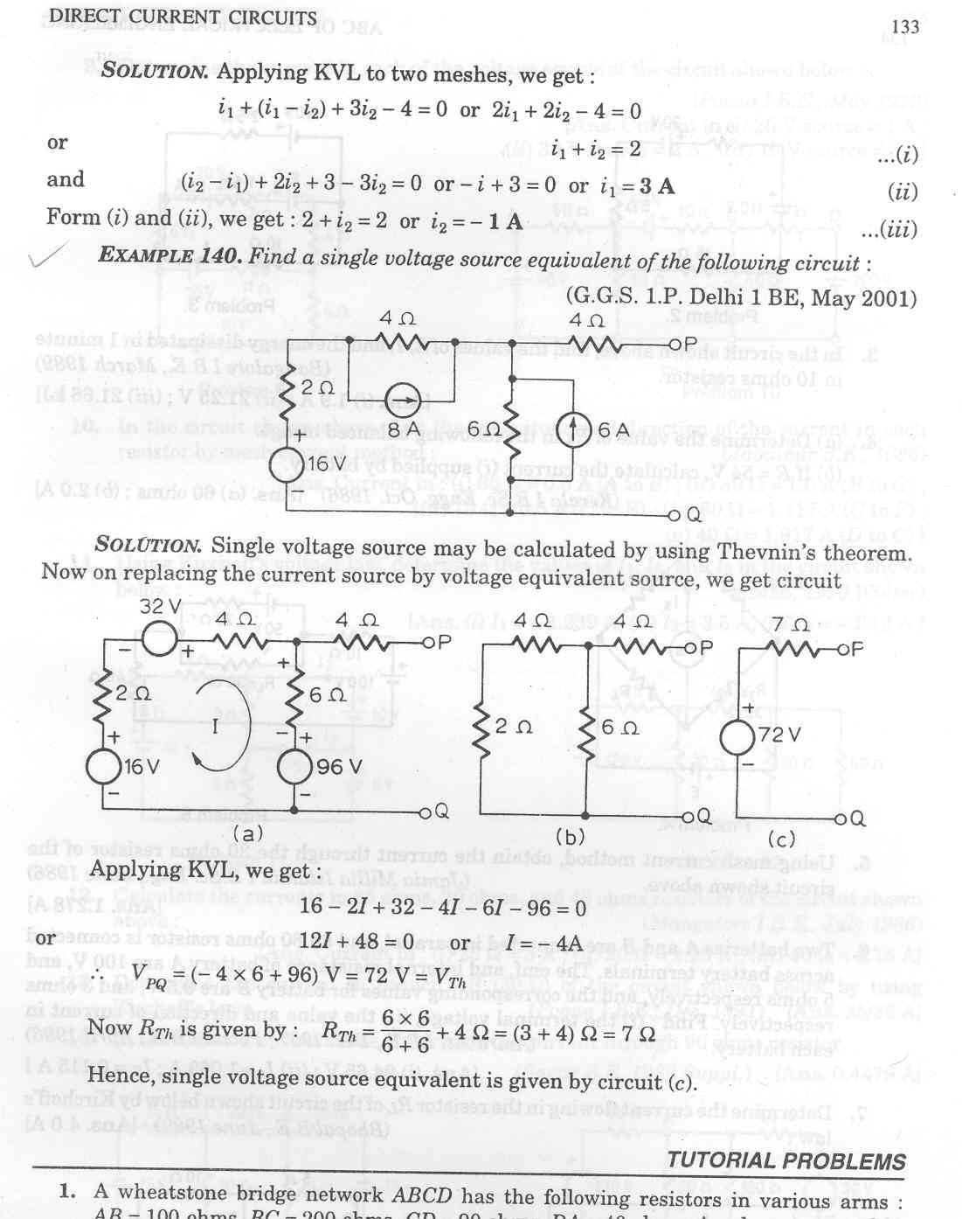
Solution : Applying KVL to the two loops,
And

Slide 13
Example
Find a single voltage source equivalent of the following circuit.

Slide 14
Solution : We first replace the current source by its equivalent voltage source. We then apply Thevenin’s Theorem.
36 V

Slide 15
Applying KVL, we get
To find Thevenin’s equivalent resistance, we reduce the network as shown.

Slide 16
Equivalent voltage source is
42 V

Slide 17
M e s h C u r r e n t A n a l y s i s w i t h C u r r e n t a n d V o l t a g e S o u r c e s
CS is placed in two situations
CS is at the side branch of any mesh
CS is common between two mashes
Assume a Voltage across CS
Supermesh

Slide 18
REFERENCES
[1] R.C. Dorf and James A. Svoboda, “Introduction to Electric Circuits”, 9th ed, John Wiley & Sons, 2013.

